Slide 1
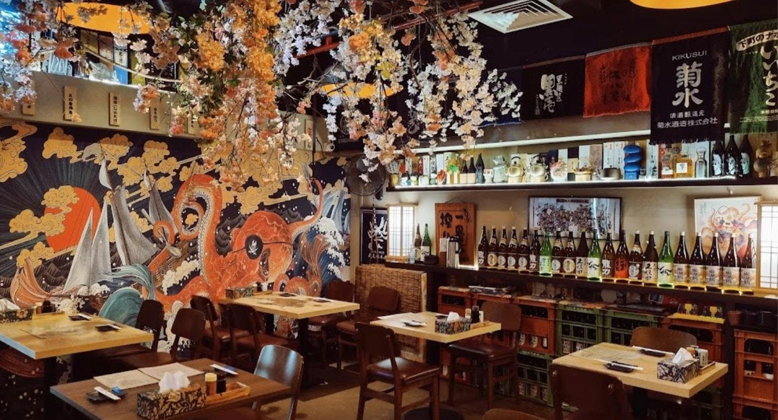


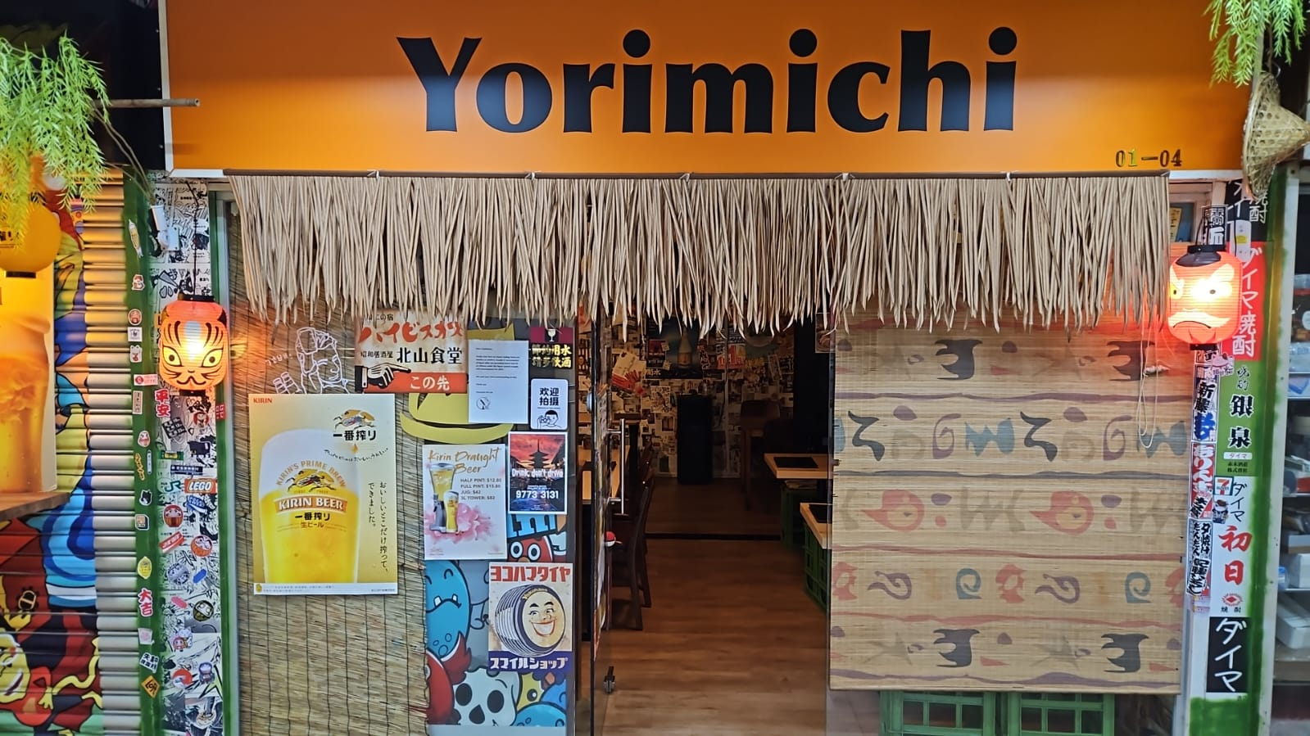
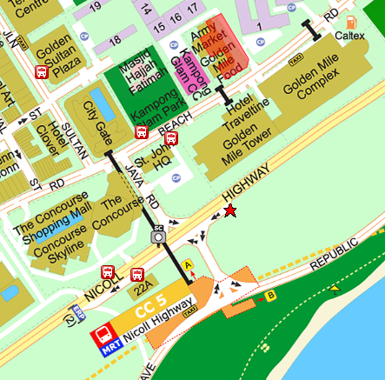
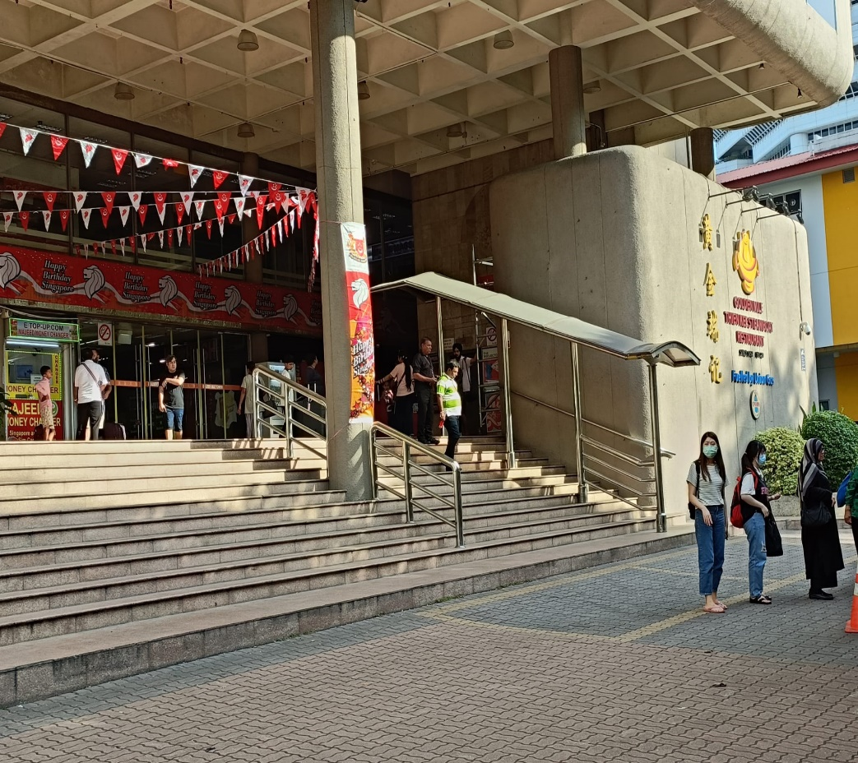
EVENT EMAIL
Dear Participant, Thank you for being a part of our upcoming Dining in the Dark event! This message serves as a reminder. We look forward to providing you with a unique and memorable experience. See you soon! For any issue on the day of the event, you can contact our staff @ 87601459 or on Whatsapp https://wa.me/6587601459 Date / Time: 13 Aug (Sun) @ 6:00 pm Place: Yorimichi Yakitori Izakaya Address: 6001 Beach Rd, #01-02 GOLDEN MILE TOWER, Singapore 199589 Verification doc: Singpass, driving licence, IC, etc Event registration: Screen shot of ticket. Below is a guide for those travelling from the train station Thanks, Jamaica G. https://www.streetdirectory.com/sg/golden-mile-complex/5001-beach-road-199588/12858_15512.html
Hi Gents, Thank you for being a part of our upcoming Dining in the Dark event! This message serves as a reminder. We look forward to providing you with a unique and memorable experience. See you soon! Please meet our staff with an Inner Soul Verse armband at the entrance of the golden mile tower for registration and verification as depicted in the photo. For any issue on the day of the event, you can contact our staff @ 87601459 or on Whatsapp https://wa.me/6587601459 Date / Time: 13 Aug (Sun) @ 6:15 pm Place: Yorimichi Yakitori Izakaya Address: 6001 Beach Rd, #01-02 GOLDEN MILE TOWER, Singapore 199589 Verification doc: Singpass, driving licence, IC, etc Event Registration: Screen shot of ticket. Below is a guide for those travelling from the train station Thanks, Jamaica G. https://www.streetdirectory.com/sg/golden-mile-complex/5001-beach-road-199588/12858_15512.html
INNER SOUL VERSE PRESENTS
13
AUG
DINING
IN THE
DARK
Introductory
Price
Ages:
Ladies: 28-38
Gentlemen: 30-40
When:
13 Aug 2023 (Sun)
6pm to 8pm
Where:
Yorimichi Yakitori Izakaya
@Beach Rd
Price includes 8 course dinner and one-to-one rotation
EVENT MANAGEMENT | Completion
Confirm date and availability of restaurant before creating event
Send event to Eventbrite 28 days in advance
Create promo codes
Create two ticket types (male/female)
Inform participants on Monday and Saturday same week as the event date to remind them and to inform meeting place
Alight at Nicholl Highway MRT.
Take Exit A.
Walk along the bridge.
Look out for the stairs that leads down to St. John HQ.
Walk farther and you would reach Golden Mile Tower.
Gentlemen
Meet at Entrance

Slide 2
Schedule
Event Item
PREP | EVENT | REMARK
4:00 - 5:15 | Setup + Dinner | Setup pipe works + curtains Setup luminous sticks at table edge Check power bank battery Check phones x2 battery Check IR camera Check speakers
6:00-6:15 | Ladies arrival | Play music Check tickets + pass them bottled water sit them in the small room Switch off light to show darkness Close the door before gentlemen enter to view the room
6:15-6:25 | Gents arrival | Wait at the entrance with the signboard Check tickets + pass them bottled water Once ready send them to see the room
DURING | EVENT | REMARK
6:25 – 6:30 | Introduction
6:30 – 7:30 | Rotation | 8-10 mins 9 mins song (0.9x speed) = 10mins 9 mins song (1.1 speed) = 8m10sec
POST | EVENT | REMARK
7:30 – 7:35 | Turn up light + Debrief + thank Xiao Yu | Participant shall gather at the back
7:35 – 7:45 | Drinks + Pack up | Participant continues
ENTRANCE SETUP | Qty | REMARK
Storage Bag | 1
Curtain | 9
Pipe works (25mm JIS K6741) ID: 32mm | 21
Safety pins and clips
ELECTRONICS | Qty | REMARK
Phone (SIM card) | 1 | Check Battery.
Music phone | 1 | Check Battery. intro music, event music, post event music
Phone | 1 | For infra red camera WIFI shall be set to 2.4 dual
Power bank | 1
IR camera | 1
Speakers | 2
MISC | Qty | REMARK
Signboard for meeting place | 1 | For the gentlemen to identify our staff.
Cotton bud | 1 pack
Sampling bottle | 30 bottles
Luminous stick | 1 pack
Disposable spoon | 1 | For dipping luminous liquid
penknife | 1
Masking tape | 1 | In case curtain torn
Note
Meals should be served in the order based on the common utensils usage.
Promo: early bird, soloideas, tgbtg

Slide 3
Event Brite (DID)
Title:
Singles Dining in the Dark
Summary:
Experience a unique dining in the dark dating event, where our taste buds awaken and our genuine connection forms
Event:
Experience a unique dining in the dark dating event, where our taste buds awaken and our genuine connection forms
This event takes place in a completely dark venue.
8﻿ dish meal is provided.
Trained staff will be available to assist participants in navigating through the darkness.
The event will only proceed when the gender ratio are relatively balanced.
We anticipate an attendance of 10-12 participants.
Rotation occur approximately every 12 minutes.
Dietary allergies and dietary requirements can be arranged.
Requirements:
For gentlemen age 30-40.
For ladies age 28-38.
Participants are shall be of unmarried marital status
Participants are to present proof of the abovementioned requirements (eg, Singpass).
Additional Information:
Contact us: i﻿nnersoulverse@gmail.com | Visit us: www.innersoulverse.com
Cancellation and refund:

Slide 4
INTRODUCTION
Greetings
Intro host
Thank Yorimichi
About IR Camera.
About recording
About participant count
Event liminous stick
Event etiquette
Event rotation
Event bite size food
We will be serving our first dish
ENDING
Participants remain seated
Dimming the lights
----- GO TO SWITCH
The moment of truth!
----- TURN ON SWITCH
Participants to move around
Thank Xiaoyu
Gather everyone towards the inner room
Serve drinks
----- SERVE DRINKS

Slide 5
SETUP
Both sides union
Both sides 5 ways
Extension Rod
Pipe
Upside down setting up
SECURE THIS ROD
TO A CHAIR
Facing door

Slide 6


GLOW
SMILES AGLOW
INNER SOUL VERSE
PRESENTS
Who:
Ladies: 28-42
:Gentlemen 28-45
An Illuminated Dining Experience
When:
02 Dec 2023
02
Dec
Where:
Yorimichi Yakitori Izakaya
@Beach Rd
烛光里的微笑

Slide 7



DID
INNER SOUL VERSE
PRESENTS
Who:
Ladies: 28-40
Gentlemen: 30-42
DINING
IN
THE
DARK
When:
07 Oct 2023
07 Oct
Where:
Yorimichi Yakitori Izakaya
@Beach Rd

Slide 8


GAME
Event Brite (GAME)
Event Title:
Singles Halloween game
Summary:
Singles Halloween game that align with your unique traits
Event:
In this Halloween, where ghostly singles unite to solve enigmatic cubes and find spectral connections. With our Game Masters as your love orchestrators, will leave you with unforgettable memories
Games and F&B. (Game is conducted in simple spoken mandarin)
We anticipate an attendance of 8 participants.
Rotation occur approximately every 10-12 minutes.
The event will only proceed when the gender ratio are relatively balanced.
There is a minimum spending requirement of $15 from the restaurant..
Requirements:
For ladies age 23 - 30.
For gentlemen age 25 - 32.
Participants are shall be of unmarried marital status.
Participants are to present proof of the abovementioned requirements (eg, Singpass).
Additional Information:
food and beverages are not included in the event and will be paid for separately by participants. There is a minimum spending requirement of $15.
Contact us: i﻿nnersoulverse@gmail.com | Visit us: www.innersoulverse.com
Cancellation and refund:
INNER SOUL VERSE
PRESENTS
THIS
OCT
Halloween
Game
Cube
(CHINESE LANGUAGE)
In this Halloween, where ghostly singles unite to solve enigmatic cubes and find spectral connections. With our Game Masters as your love orchestrators, will leave you with unforgettable memories.
想要来一场不一样的万圣之旅吗？透过游戏大师的“穿针引线”，认识志同道合的朋友，一起寻幽探秘，解开重重谜底。在魔幻的游戏世界里，一同留下难忘的回忆。也许您正等待的那一个特别的他/她会在这一刻相遇？
Note:
Game will be conducted in simple spoken mandarin
Ages
Female: 23 - 30
Male: 25 - 32
Where:
Yorimichi Yakitori
Izayaka
@ Beach Rd
When
Coming This Oct

Slide 9

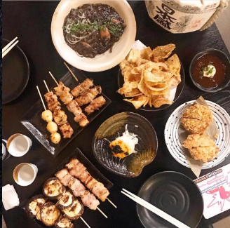
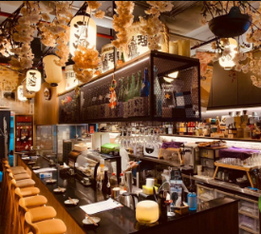
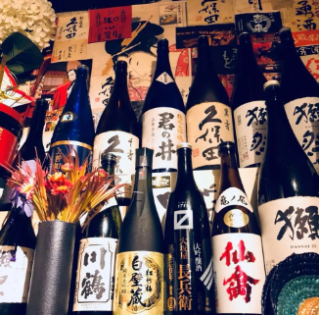
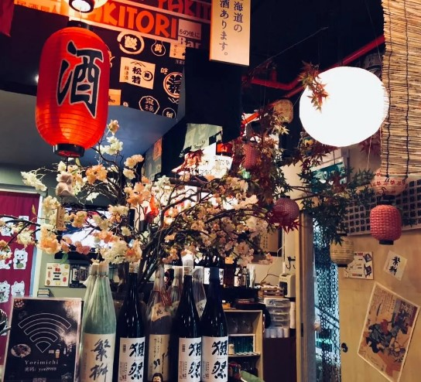
PUB
INNER SOUL VERSE
PRESENTS
Carpe vinum Carpe diem
THIS
OCT
Seize the Wine (Sake), Seize the Day!
With hearts aglow and spirits free,
In this event, our souls shall be,
A celebration of the single heart,
Where meaningful connections start
Ages:
Ladies: 30-48
Gentlemen: 30-48
When:
Comng This Oct
Where:
Yorimichi Yakitori Izakaya
@Beach Rd
Price includes facilitation only.
See event details for minimum spending

Slide 10




ENCORE
INNER SOUL VERSE
PRESENTS
THIS
OCT
ENCORE
The past a stepping stone
A new chapter awaits
A second chance to connect
A new future to greet
Who:
Romantics seeking a second chance in love.
When:
Coming this Oct
Where:
Yorimichi Yakitori Izakaya
@Beach Rd

Slide 11



KTV
09
SEPT
INNER SOUL VERSE
PRESENTS
SING YOUR HEARTS OUT
...And love will find its way
Ages:
Ladies: 25-42
Gentlemen: 25-42
Where:
Yorimichi Yakitori Izakaya
@Beach Rd
When:
09 Sept 2023
4pm – 7pm

Slide 12



VEGAN
INNER SOUL VERSE
PRESENTS
07
Oct
GREEN HEARTS
Find that herbivore who shares your values and love for all things plant-based. Elevate your romance with the power of plant-powered connections while savouring guilt-free vegan cuisine
Ages:
Ladies: 25-40
Gentlemen: 30-45
Where:
Yorimichi Yakitori Izakaya
@Beach Rd
When:
07 Oct 2023
6pm – 8pm

Slide 13
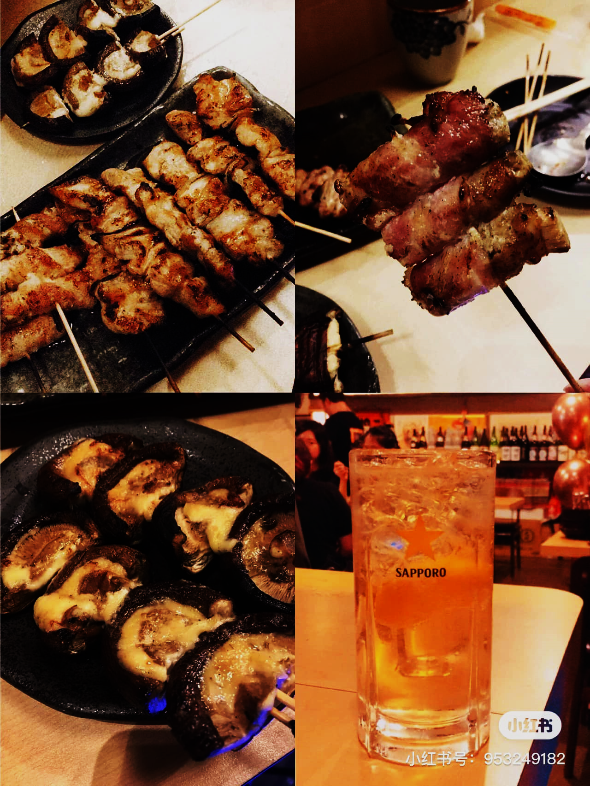


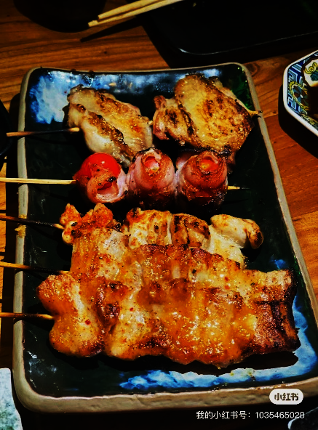
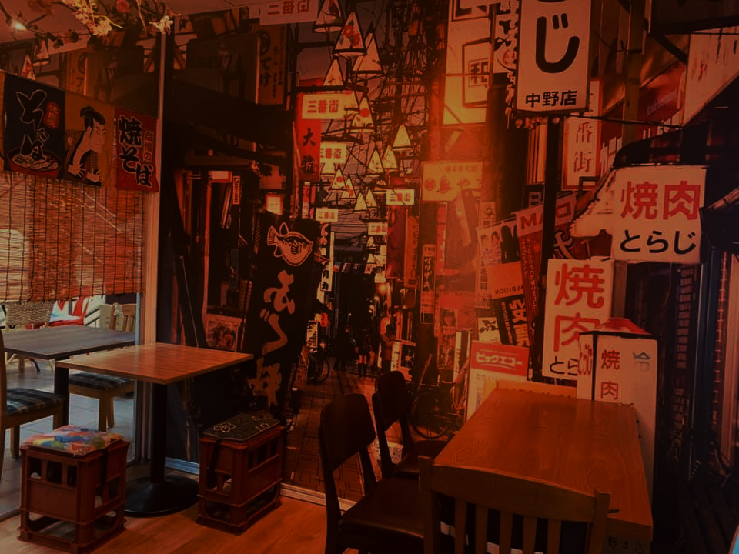
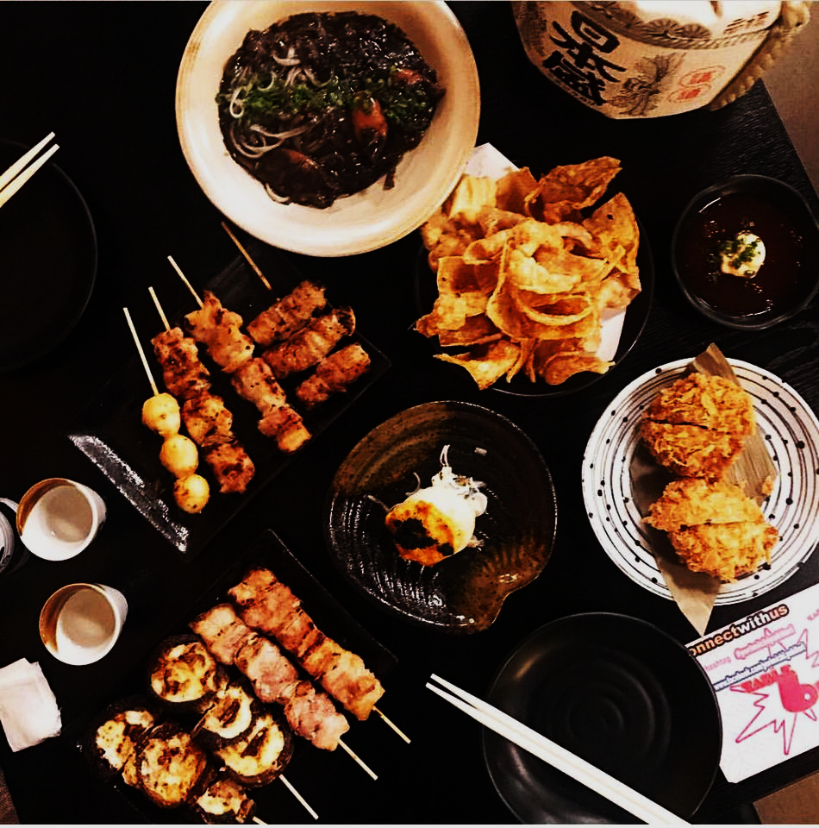
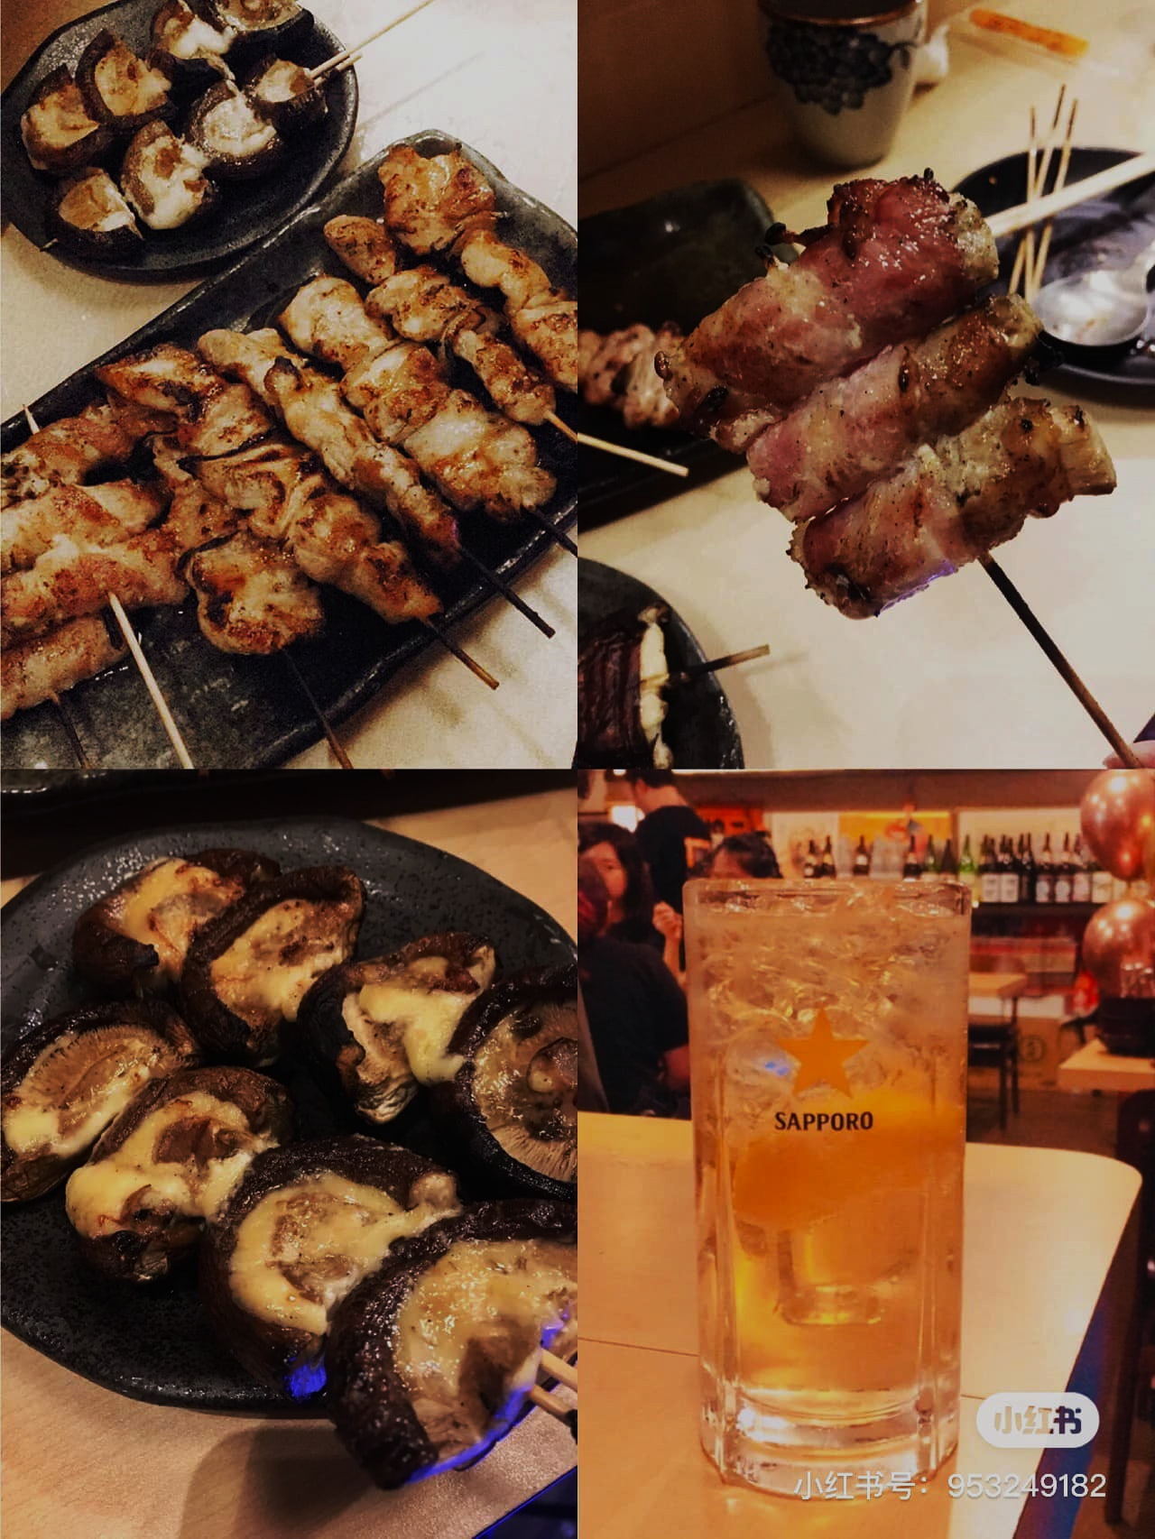
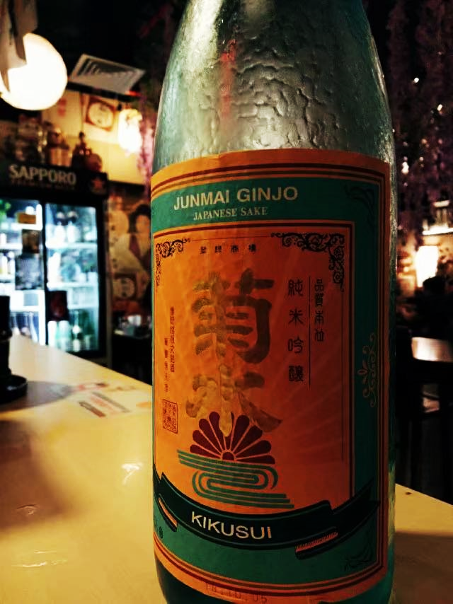
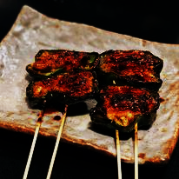

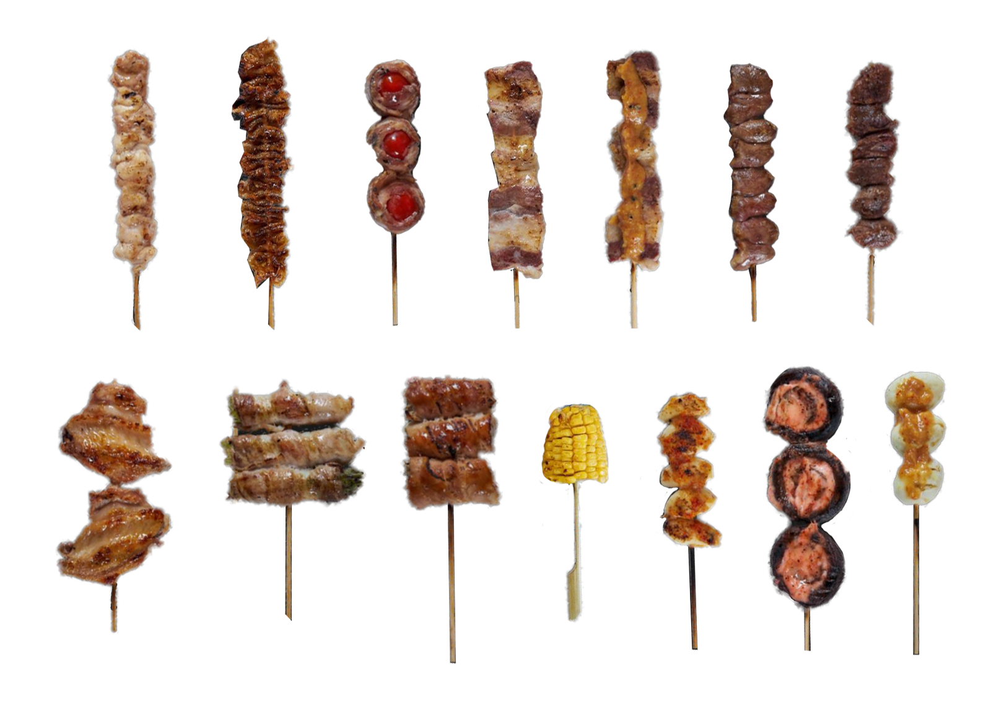

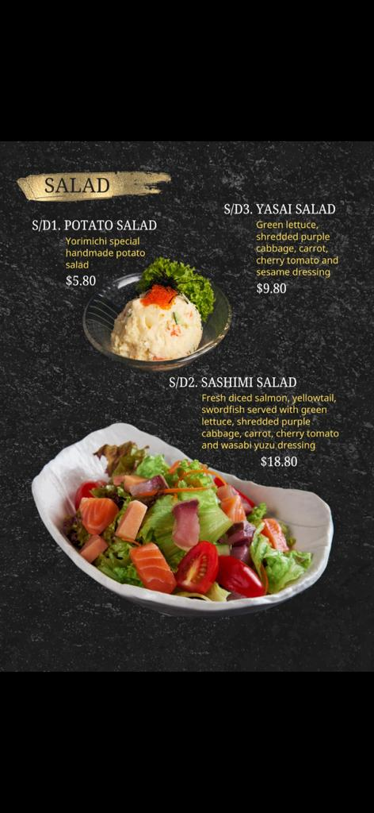
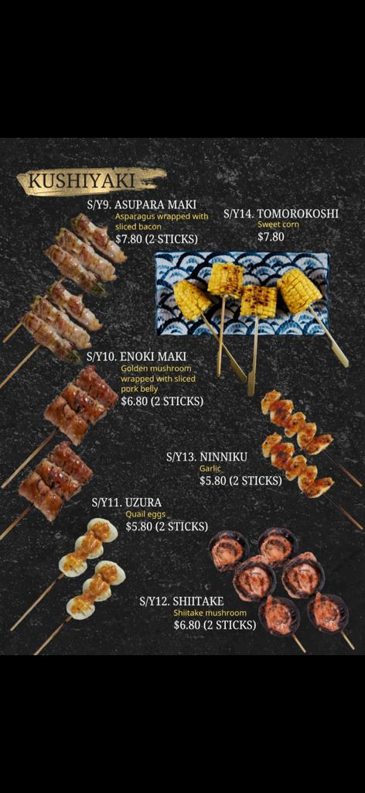
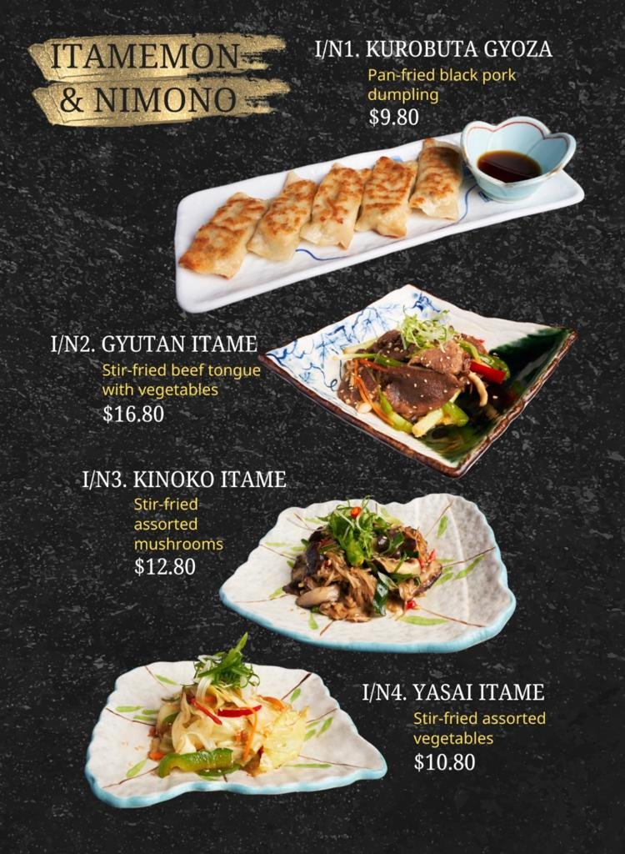
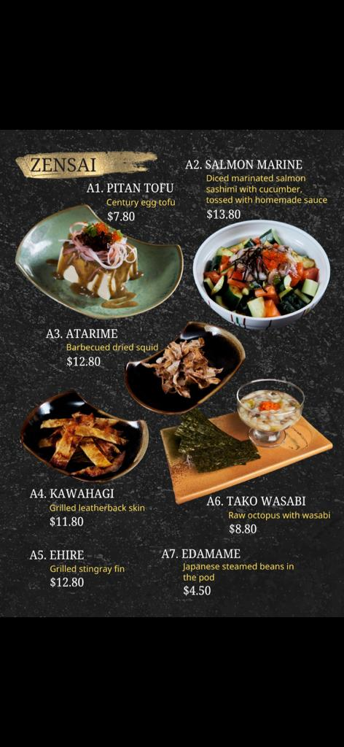
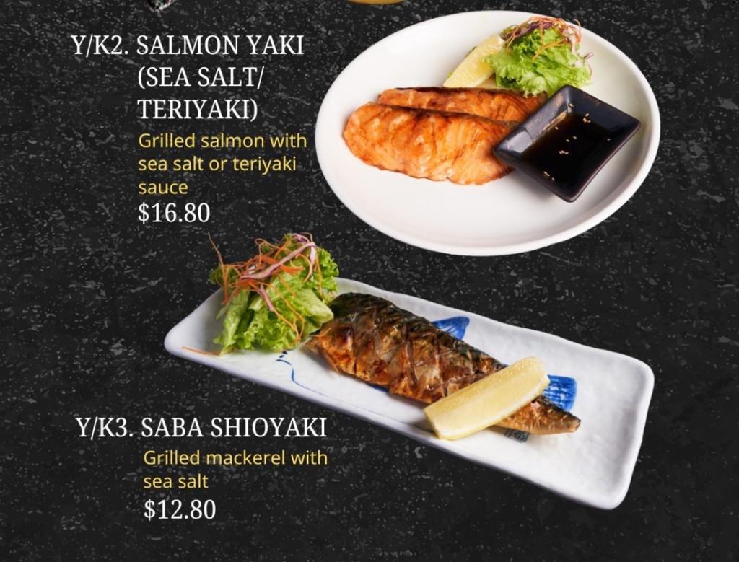

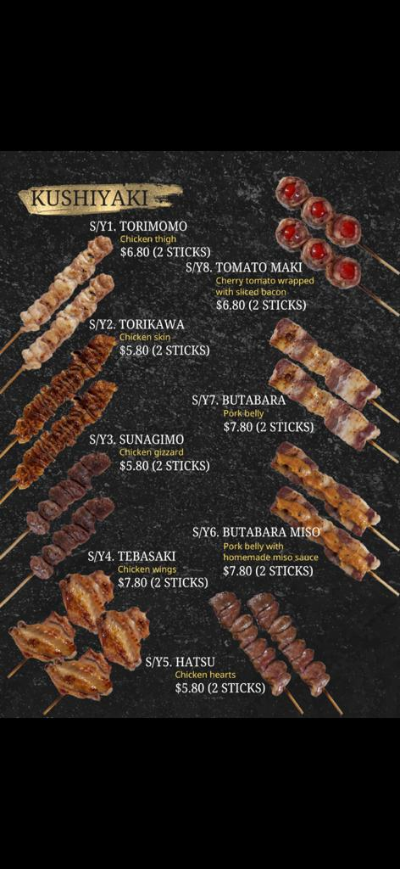
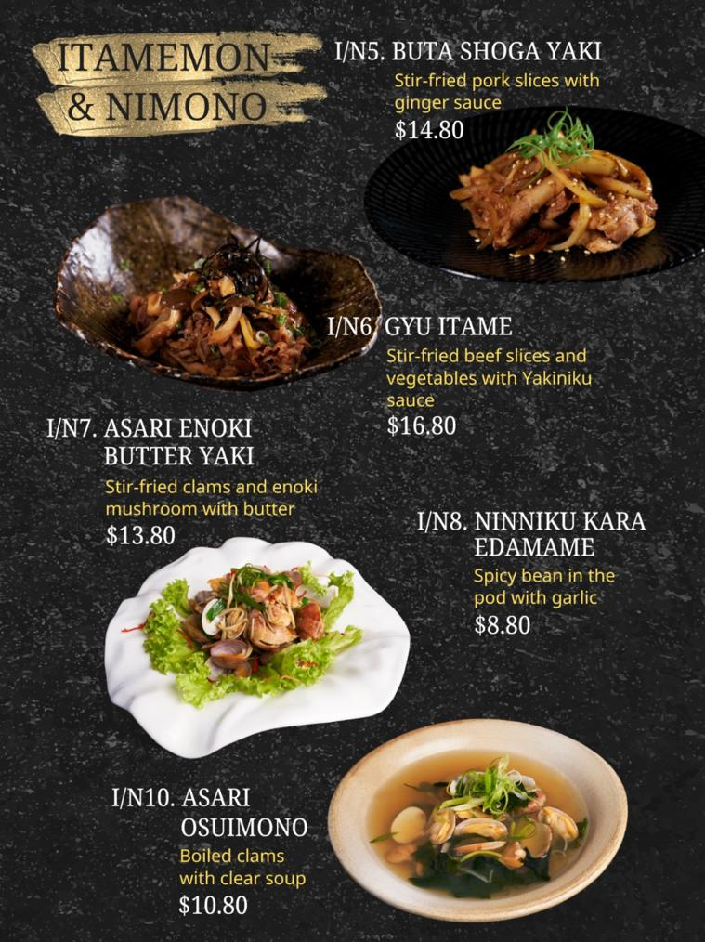
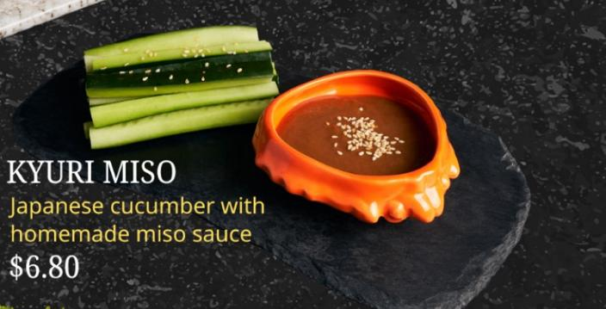
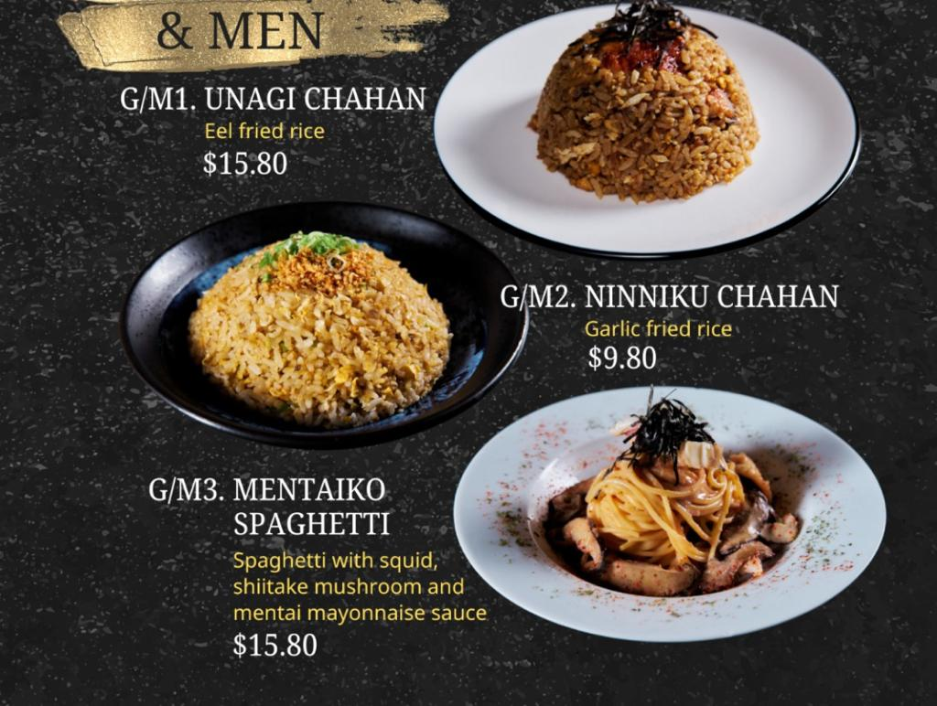
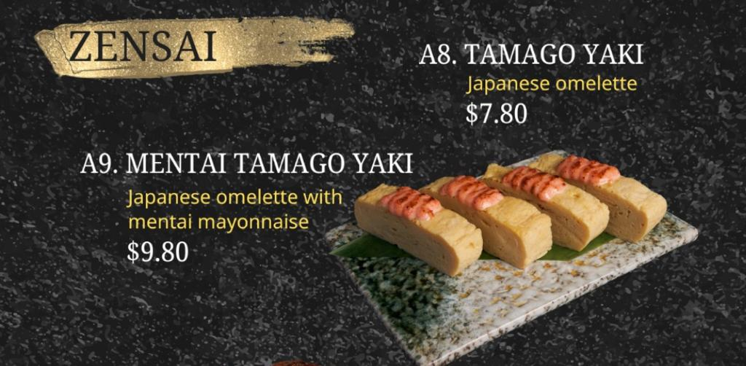
INNER SOUL VERSE
PRESENTS
28
Oct
Wolf Down Buffet
Get ready
for an evening
of feasting and mingling to the
tantalizing aroma and flavors of yakitori.
Ages:
Ladies: 25-42
Gentlemen: 28-45
Where:
Yorimichi Yakitori Izakaya
@Beach Rd
When:
28 Oct 2023
6pm – 8pm
WOLF
Zensai
Century egg tofu
Salmon Marine
Barbequed dried squid
Grill leatherback skin
Grilled stringray fin
Raw octopus with wasabi
Japanese steamed beans in pod
Tamago Yaki
mentai tamago yaki
INNER SOUL VERSE PRESENTS
WOLF DOWN BUFFET
Get ready
for an evening
of feasting and mingling to the
tantalizing aroma and flavors of yakitori
Ages:
Ladies: 25-42
Gentlemen: 28-45
Where:
Yorimichi Yakitori Izakaya
@Beach Rd
When:
28 Oct 2023
6pm – 8pm
Fish
Salmon Yaki
Saba Shioyaki
Grilled salmon
28
Oct
Kushiyaki
Chicken tight
Chicken skin
Chicken gizzard
Chicken wings
Chicken hearts
Porkbelly with homemade miso sauce
Pork belly
Cherry tomato wrapped with sliced bacon
Asparagus wrapped with sliced bacon
Golden mushroom wrapped with sliced pork belly
Quail eggs
Shitake mushroom
Garlic
Sweet corn
A la carte
buffet menu
Kushiyaki
Chicken tight
Chicken skin
Chicken gizzard
Chicken wings
Chicken hearts
Porkbelly with homemade miso sauce
Pork belly
Cherry tomato wrapped with sliced bacon
Asparagus wrapped with sliced bacon
Golden mushroom wrapped with sliced pork belly
Quail eggs
Shitake mushroom
Garlic
Sweet corn
Zensai
Century egg tofu
Salmon Marine
Barbequed dried squid
Grill leatherback skin
Grilled stringray fin
Raw octopus with wasabi
Japanese steamed beans in pod
Tamago Yaki
mentai tamago yaki
Salad
Potato salad
Sashimi salad
Green lettuce, cabbage, carrot, cherry tomato
Kyuri miso
Itamemon & Nimono
Kurobuta gyoza
Beef tongue (Gyutan Itame)
Mushrooms (Kinoko Itame)
Stir fried vegetable
Stir-fried pork slices
Sitr-fried beef slices and vegetable
Stir-fried clams with enoki mushroom
Spicy beans in the pod with garlic
Boiled clams with clear soup
Men
Eel fried rice
Garlic fried rice
Mentaiko sphagetti
Salad
Potato salad
Sashimi salad
Green lettuce, cabbage, carrot, cherry tomato
Kyuri miso
Fish
Salmon Yaki
Saba Shioyaki
Grilled salmon
Note:
Only water is included.
Men
Eel fried rice
Garlic fried rice
Mentaiko sphagetti
Itamemon & Nimono
Kurobuta gyoza
Beef tongue (Gyutan Itame)
Mushrooms (Kinoko Itame)
Stir fried vegetable
Stir-fried pork slices
Sitr-fried beef slices and vegetable
Stir-fried clams with enoki mushroom
Spicy beans in the pod with garlic
Boiled clams with clear soup
A la carte
buffet menu

Slide 14


HIKE

Slide 15

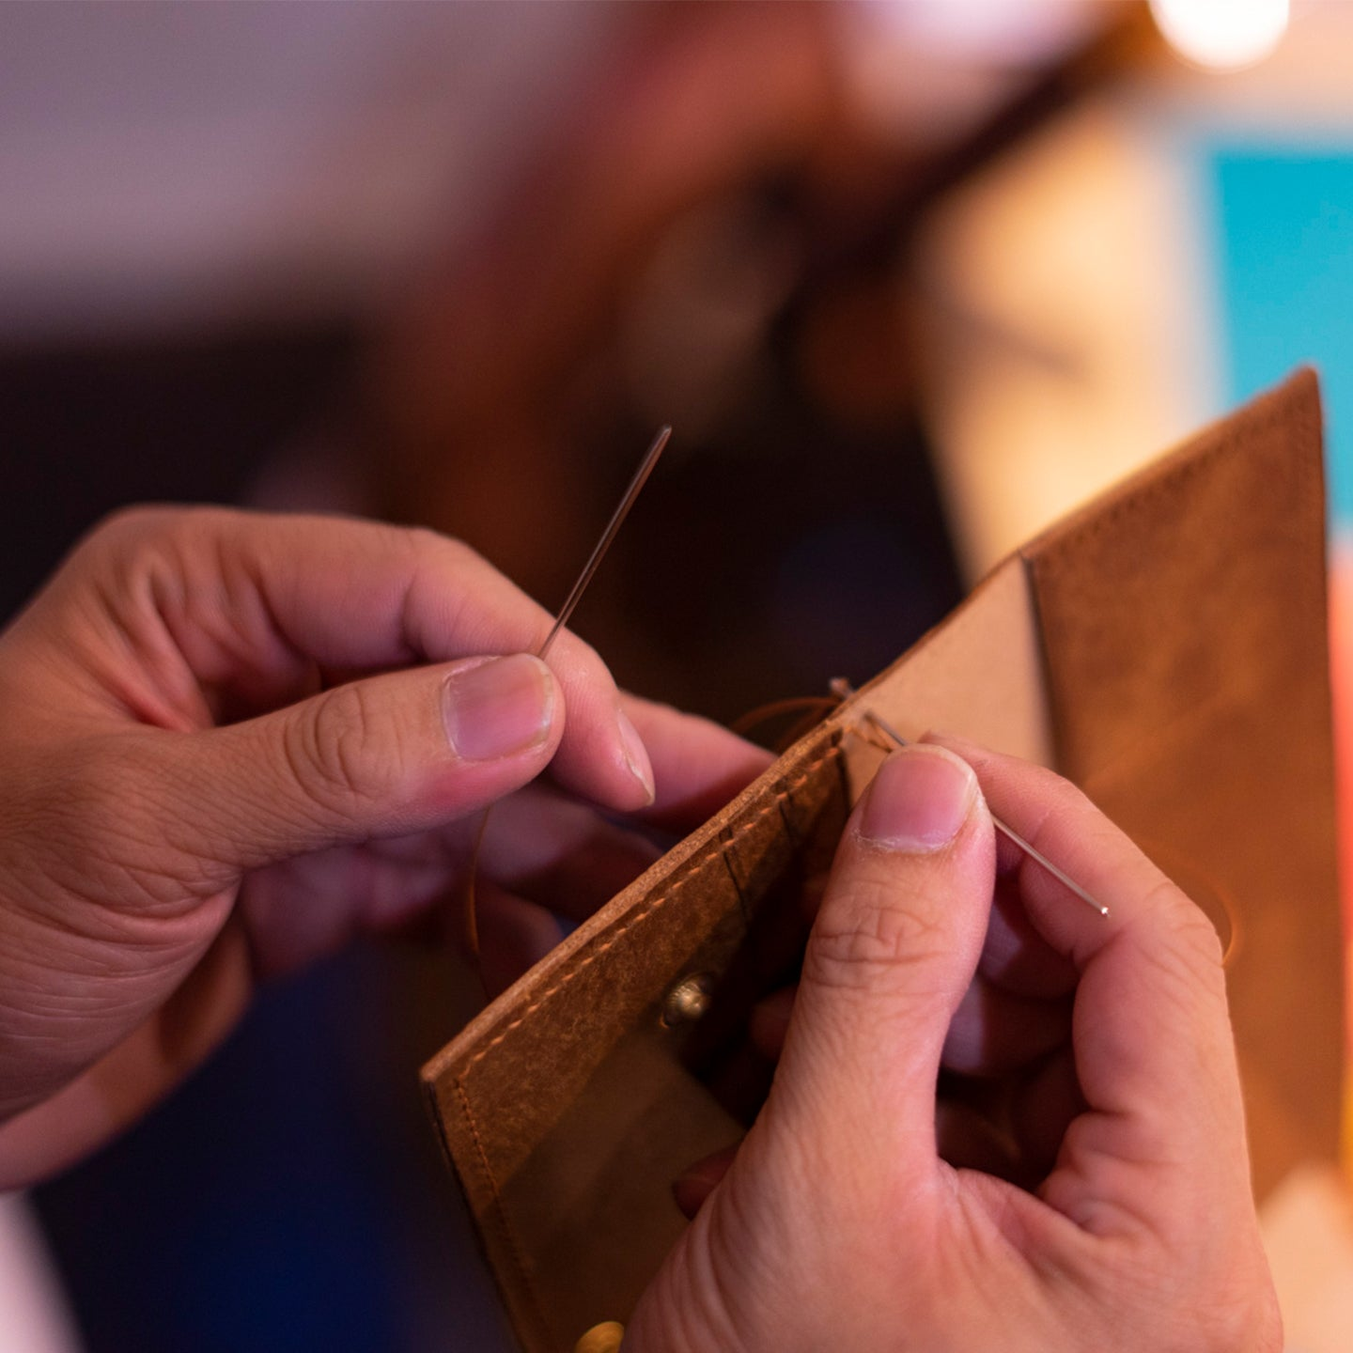






25
Nov
INNER SOUL VERSE PRESENTS
Leather Works Wonders
Workshop
This workshop brings together singles who share a love for leatherworking.
Under the guidance of skilled craftsmen, you'll learn the basic, select from a vibrant array of colors, and personalize your creations with hot stamping.
WORKS
Ages:
Ladies: 25-42
Gentlemen: 28-45
When:
25 Nov 2023
5pm – 7pm
Where:
Crafune
38 Haji Ln, #02-01, Singapore 189231
25
Nov
Ages:
Ladies: 25-42
Gentlemen: 28-45
When:
25 Nov 2023
4.30pm – 6.30pm
Where:
Momolato
34 Haji Ln
S189227
Ice Dreams
Workshop
INNER SOUL VERSE PRESENTS
25
Nov
Whether you're a seasoned dancer or two-left-footed novice, rest assured that our dance is thoughtfully curated for this event.
No need to worry about stepping on your partner's toes—we've got you covered
Ages:
Ladies: 25-42
Gents: 28-45
When:
25 Nov 2023
5pm – 7pm
Where:
Jump Five Dance Academy
Bugis Cube,
#04-12
S188735
Two Left
Workshop

Slide 16

Important. Please read:
This event will only proceed when the number of participants has reached and the gender ratio are relatively balanced.
We will notify you to proceed with the payment (see below price) through Paynow. This step secures your reservation and allows us to effectively plan for the event and reduce the possibility of no-shows.
GENERAL
EVENT EMAIL
Dear Participant, Thank you for being a part of our upcoming Dining in the Dark event! This message serves as a reminder. We look forward to providing you with a unique and memorable experience. See you soon! For any issue on the day of the event, you can contact our staff @ 87601459 or on WhatsApp https://wa.me/6587601459 (Note: This is a dedicated tel nr that will only be activated on the day of the event to facilitate any logisitical issues) Date / Time: 13 Aug (Sun) @ 6:00 pm Place: Yorimichi Yakitori Izakaya Address: 6001 Beach Rd, #01-02 GOLDEN MILE TOWER, Singapore 199589 Verification doc: Singpass, driving licence, IC, etc Event registration: Screen shot of ticket. Below is a guide for those travelling from the train station Thanks, Jamaica G. https://www.streetdirectory.com/sg/golden-mile-complex/5001-beach-road-199588/12858_15512.html
Hi Gents, Thank you for being a part of our upcoming Dining in the Dark event! This message serves as a reminder. We look forward to providing you with a unique and memorable experience. See you soon! Please meet our staff with an Inner Soul Verse armband at the entrance of the golden mile tower for registration and verification as depicted in the photo. For any issue on the day of the event, you can contact our staff @ 87601459 or on WhatsApp https://wa.me/6587601459 (Note: This is a dedicated tel nr that will only be activated on the day of the event to facilitate any logisitical issues) Date / Time: 13 Aug (Sun) @ 6:15 pm Place: Yorimichi Yakitori Izakaya Address: 6001 Beach Rd, #01-02 GOLDEN MILE TOWER, Singapore 199589 Verification doc: Singpass, driving licence, IC, etc Event Registration: Screen shot of ticket. Below is a guide for those travelling from the train station Thanks, Jamaica G. https://www.streetdirectory.com/sg/golden-mile-complex/5001-beach-road-199588/12858_15512.html
EVENT EMAIL
Dear Participant, Thank you for being a part of our upcoming XXXXX event ! This message serves as a reminder. We look forward to providing you with a unique and memorable experience. See you soon! On the day of the event, you can contact our staff @ 87601459 or on WhatsApp https://wa.me/6587601459 (Note: This is a dedicated tel nr that will only be activated on the day of the event to facilitate any logisitical issues) Date / Time: 07 Oct (Sat) @ 6:00 pm Place: Yorimichi Yakitori Izakaya Address: 6001 Beach Rd, #01-02 GOLDEN MILE TOWER, Singapore 199589 Verification doc: Singpass Event registration: Screen shot of ticket. Below is a guide for those travelling from the train station Thanks, Jamaica G. https://www.streetdirectory.com/sg/golden-mile-complex/5001-beach-road-199588/12858_15512.html
IMBALANCE EMAIL
Dear participants, Thank you for registering with us for the upcoming XXXXX event. Here's an important update regarding the event. We are currently experiencing an imbalance in the gender ratio among our participants, specifically with a shortage of male participants. Although we have received expressions of interest from some male individuals, they have yet to complete their registration, and we remain hopeful. Please stay tuned for our update this Friday evening. In the event of a cancellation, rest assured that we will provide a full refund. Sincerely, Jamaica
Important. Please read:
This event will only Proceed when the number of participants has reached and the gender ratio are relatively balanced.
We will notify you to proceed with the Payment (see below price) through Paynow. This step secures your reservation and allows us to effectively plan for the event and reduce the possibility of no-shows.
Additional Information:
The arrangement of the event may be adjusted to accommodate the number of participants.
If you're slightly outside the age range, please check with us before purchasing.
Contact us: i﻿nnersoulverse@gmail.com | Visit us: www.innersoulverse.com
Cancellation and refund:
Cancellations made within 24 hours of purchase : Refund 90% of the ticket price.
Cancellations made up to 7 days prior to the event : Refund 50% of the ticket price.
Cancellations made up to 3 days prior to the event : Refund 15% of the ticket price.
Participants who don't meet the event's requirements : No Refund
Cancellation of event by organizer : Full refund
Please allow up to 3 business days for the refund.
Event Brite (DID)
Event Title:
Singles Dining In The Dark
Event Summary:
Experience a unique dining in the dark dating event, where our taste buds awaken and our genuine connection forms
Event:
Dining event.
This event takes place in a completely dark venue.
8﻿ dish meal is provided. The chef determines the food served, leading to variations from one event to another.
Trained staff will be available to assist participants in navigating through the darkness.
We anticipate an attendance of 10-14 participants.
Rotation occur approximately every 8-10 minutes.
Dietary allergies and dietary requirements can be arranged.
The event will only proceed when the gender ratio are relatively balanced.
Requirements:
For gentlemen age 30-42.
For ladies age 28-40.
Participants are shall be of unmarried marital status
Participants are to present proof of requirements (eg, Singpass).
Event Brite (ENCORE)
Event Title:
Singles Encore Dining
Event Summary:
Encore event aims at those who believe in second chances in love
Event:
Encore event aims at those who believe in second chances. Let your heart be open to the gentle possibility of love's encore. If you're divorced, a single parent, or simply unattached, Encore provides the perfect platform for you to connect, mingle, and potentially find that remarkable person who resonates with your unique journey.
Dining session.
We anticipate an attendance of 10-12 participants.
Event facilitation will be available to ensure participants have the opportunity to interact and mingle with each other.
There is a minimum spending requirement of $20 at the restaurant.
Requirements:
Participants are shall be of unmarried marital status
Participants are to present proof of the abovementioned requirements (eg, Singpass).
Event Brite (KTV)
Event Title::
Singles karaoke
Event Summary:
Singles karaoke, Food & drinks, set against a backdrop of exciting lighting
Event:
Showcase your vocal talents. Or simply sit back and relish the event’s entertainment. Enhanced by a backdrop of exhilarating lighting, you're in for an absolute blast
Karaoke session.
Food orders will commence at 5pm onwards.
We anticipate an attendance of 10-12 participants.
Rotation occur approximately every 10-12 minutes.
The event will only proceed when the gender ratio are relatively balanced.
There is a minimum spending requirement of $20 from the restaurant.
Requirements:
For ladies age 25 - 42.
For gentlemen age 25 - 42.
Participants are shall be of unmarried marital status
Participants are to present proof of the abovementioned requirements (eg, Singpass).
Event Brite (WOLF)
Event Title:
Singles Wolf Down Buffet Dining
Event Summary:
This event is specially designed for singles buffet aficionados and those who relish the tantalizing aroma and flavors of yakitori.
Event:
This event is specially designed for buffet aficionados and those who relish the tantalizing aroma and flavors of yakitori.
A la carte buffet. Ice water will be provided.
We anticipate an attendance of 10-12 participants.
Facilitation for participants to mingle.
Requirements:
For ladies age 25 - 42.
For gentlemen age 28 - 45.
Participants are shall be of unmarried marital status
Participants are to present proof of the abovementioned requirements (eg, Singpass).
Event Brite (GREEN)
Event Title:
Singles Vegan Dining
Event Summary:
A dining event designed for vegan singles to meet, mingle, and make plantiful connections.
Event:
Find that herbivore who shares your values and love for all things plant-based. Elevate your romance with the power of plant-powered connections while savouring guilt-free vegan cuisine
Curated dinner. Our talented chefs have curated a menu (appetizer, main, side, drinks, dessert) that celebrates the bounty of nature's goodness that is entirely plant-based and free from animal products such as eggs, dairy, and more.
We anticipate an attendance of 10-12 participants.
Rotation occur approximately every 10-12 minutes.
The event will only proceed when the gender ratio are relatively balanced.
Requirements:
For ladies age 25 - 40.
For gentlemen age 30 - 45.
Participants are shall be of unmarried marital status
Participants are to present proof of the abovementioned requirements (eg, Singpass).
Event Brite (DANCE)
Important. Please read:
Please be aware that, given the dynamic nature of dance workshops, there may be an uneven gender ratio.
As we have different events running concurrently, we would like you to join us for a get together session with attendees from the other event. (To be advised on the day of the event)
Event Title:
Singles Two Left (Partner Dance Workshop)
Event Summary:
An upbeat and enjoyable partner dance session with singles
Event:
This workshop is in partnership with JUMP FIVE DANCE ACADEMY. https://www.jumpfivedance.com/adults
This workshop is cheoreographed to be a light and fun partner dance session.
We anticipate an attendance of 6-10 participants.
Requirements:
For ladies age 25 - 42.
For gentlemen age 28 - 45.
Participants are shall be of unmarried marital status
Participants are to present proof of the abovementioned requirements (eg, Singpass).
Event Brite (ICE)
Event Title:
Singles Ice Dreams (Ice-Cream Workshop)
Event Summary:
Share scoops of laughs in a Fun, Frozen, & Flavorful Ice Cream Workshop
Event:
This workshop is in partnership with MOMOLATO. https://momolato.com/
different flavours to choose from.
Vegan flavour option available
We anticipate an attendance of 8-10 participants.
Requirements:
For ladies age 25 - 42.
For gentlemen age 28 - 45.
Participants are shall be of unmarried marital status
Participants are to present proof of the abovementioned requirements (eg, Singpass).
Event Brite (LEATHER)
Event Title:
Singles Leather Works Wonders (Leatherworking Workshop)
Event Summary:
Learn leatherworking craft and meet like minded singles
Event:
This workshop is in partnership with CRAFUNE. https://crafune.com/
Learn to trace, but and assemble a set of card case,, key fob, and valet tray with brass hardware. Complete with edge burnishing for a smooth and comfortable grip. Personalized with initials or names.
We anticipate an attendance of 8-10 participants.
Requirements:
For ladies age 25 - 42.
For gentlemen age 28 - 45.
Participants are shall be of unmarried marital status
Participants are to present proof of the abovementioned requirements (eg, Singpass).

Slide 17
Innersoulverse operates on an innovative model, much like a Platform as a Service (PaaS). We extend an open invitation to individuals, offering access to our cutting-edge technology, a vast customer base, and a versatile platform, empowering them to host and organize events with unprecedented ease and efficiency

